Slide 1
UML Sequence diagram

Slide 2
Sequence Diagram(make a phone call)
Caller
Phone
Recipient
Picks up
Dial tone
Dial
Ring notification
Ring
Picks up
Hello
Notes:
‹#›

Slide 3
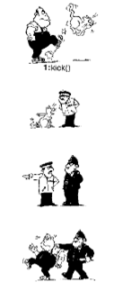
Person kicks the cat
Cat reports to inspector
Inspector reports to Policeman
Policeman arrests person
Slide ‹#›

Slide 4
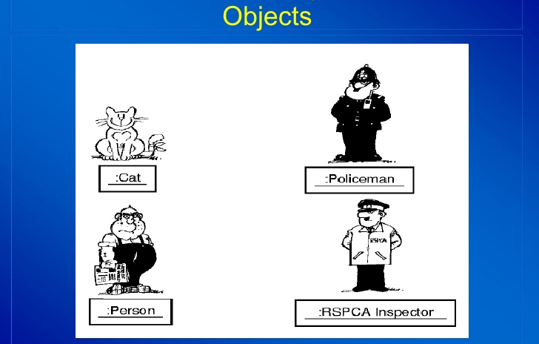
Slide ‹#›

Slide 5
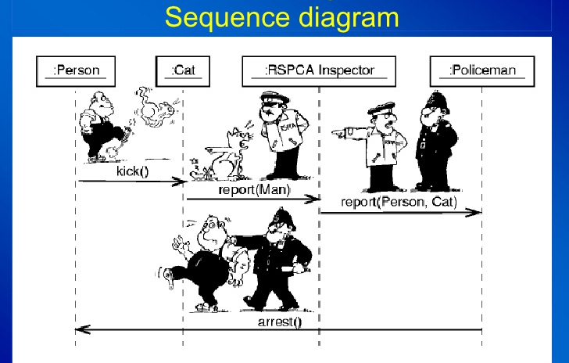
Slide ‹#›

Slide 6
Sequence Diagrams
Dynamic model
Illustrate the objects that participate in a use-case
Show the sequence of messages that pass between objects for a particular use-case over time
Example: order food, change tv channel
It models a single scenario executing in the system
Slide ‹#›

Slide 7
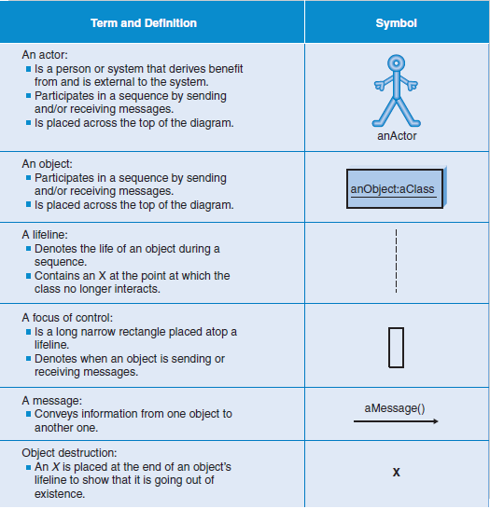

Slide 8
Sequence Diagrams – Object Life Spans
Creation
Create message
Object life starts at that point
Activation
Symbolized by rectangular stripes
Place on the lifeline where object is activated.
Rectangle also denotes when object is deactivated.
Deletion
Placing an ‘X’ on lifeline
Object’s life ends at that point
A
Create
B
Activation bar
X
Return
Deletion
Lifeline
Notes:
‹#›

Slide 9
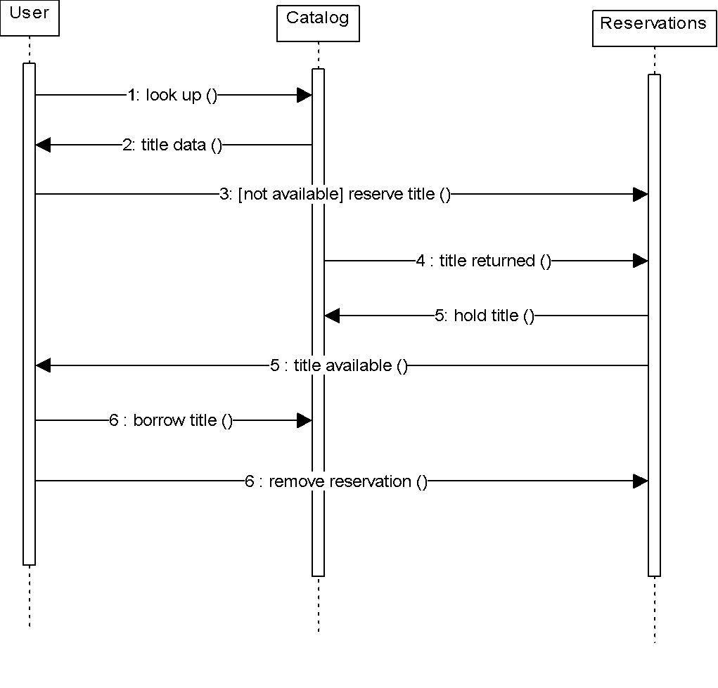
Sequence Diagram
Sequence diagrams demonstrate the behavior of objects in a use case by describing the objects and the messages they pass.
The horizontal dimension shows the objects participating in the interaction.
The vertical arrangement of messages indicates their order.
The labels may contain the seq. # to indicate concurrency.
Message
Notes:
‹#›

Slide 10
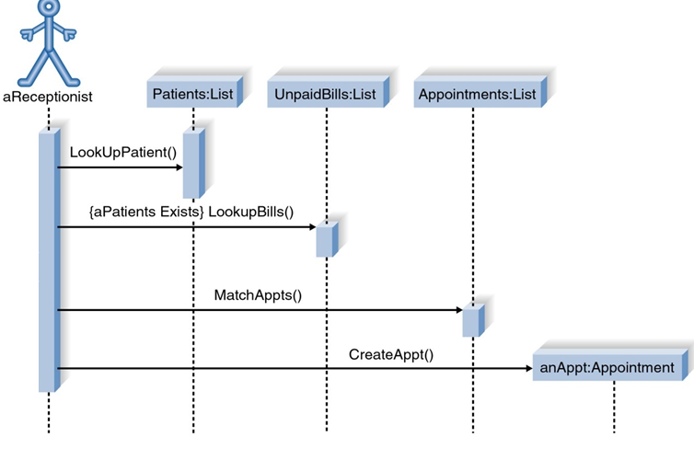
Sequence Diagram for Patient appointment Use Case
Slide ‹#›
Notes:
‹#›

Slide 11
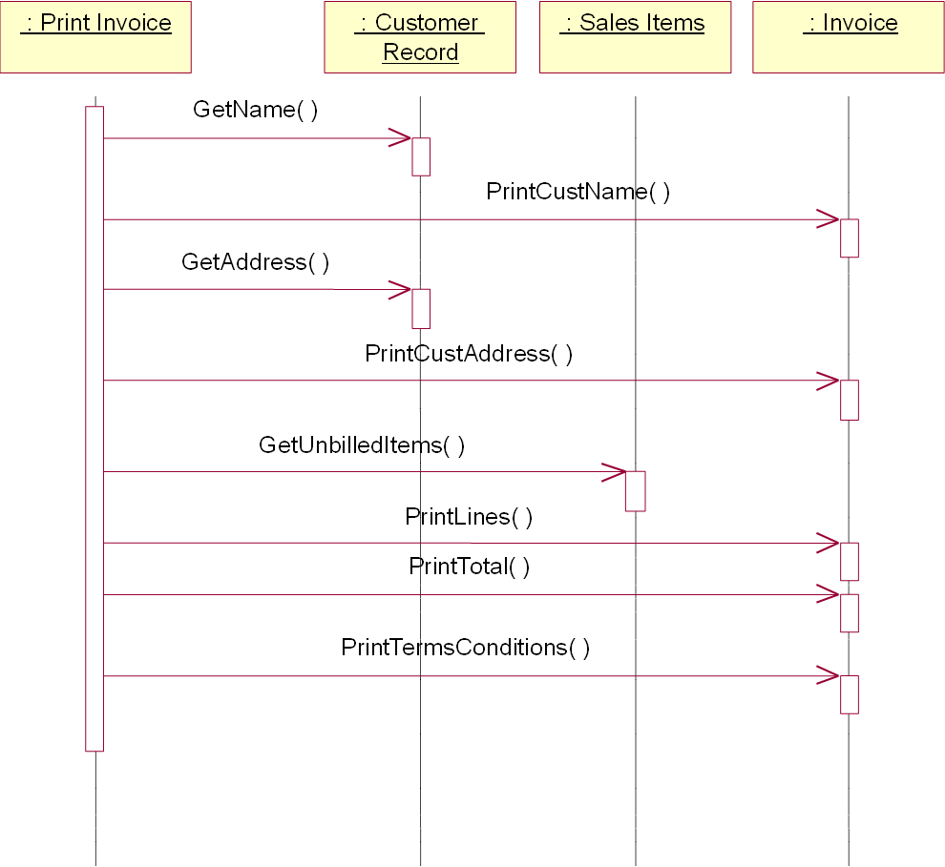
Sequence Diagram for Print Invoice use case

Slide 12
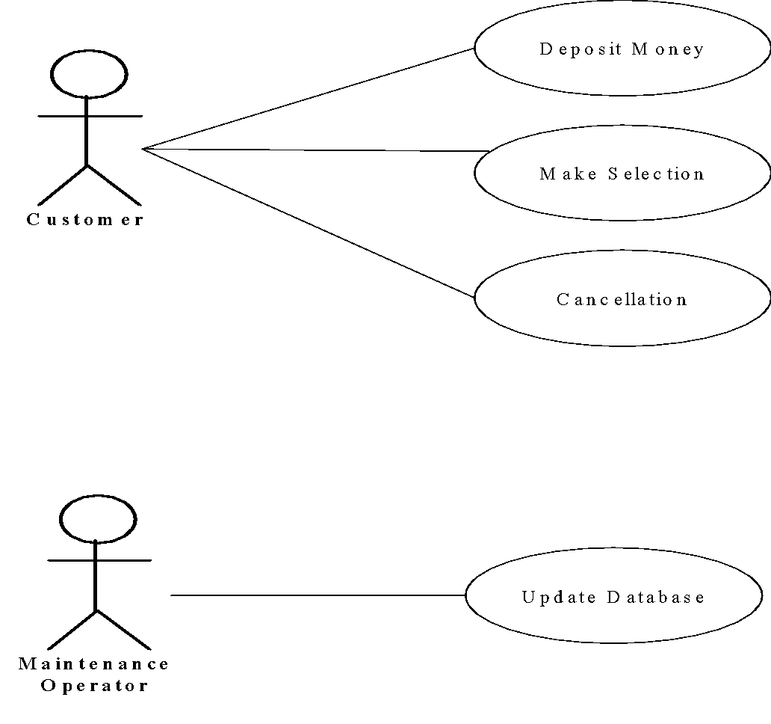
Example: Use Case Diagram of the Vending Machine

Slide 13
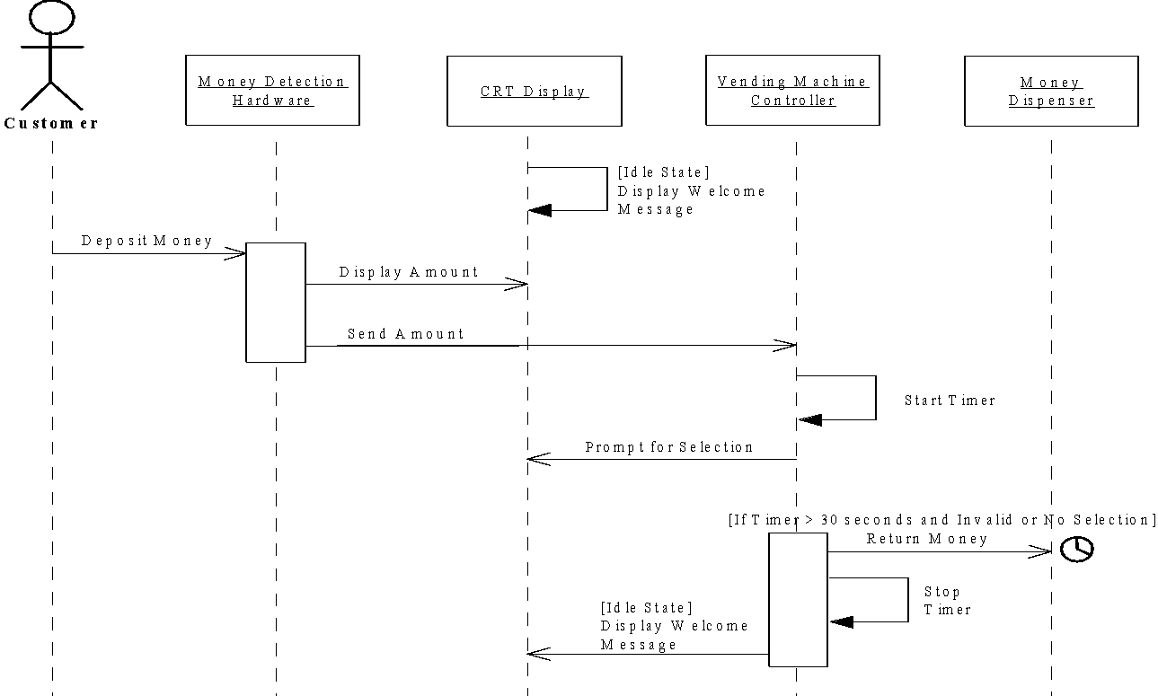
Sequence Diagram for Deposit Money Use Case

Slide 14
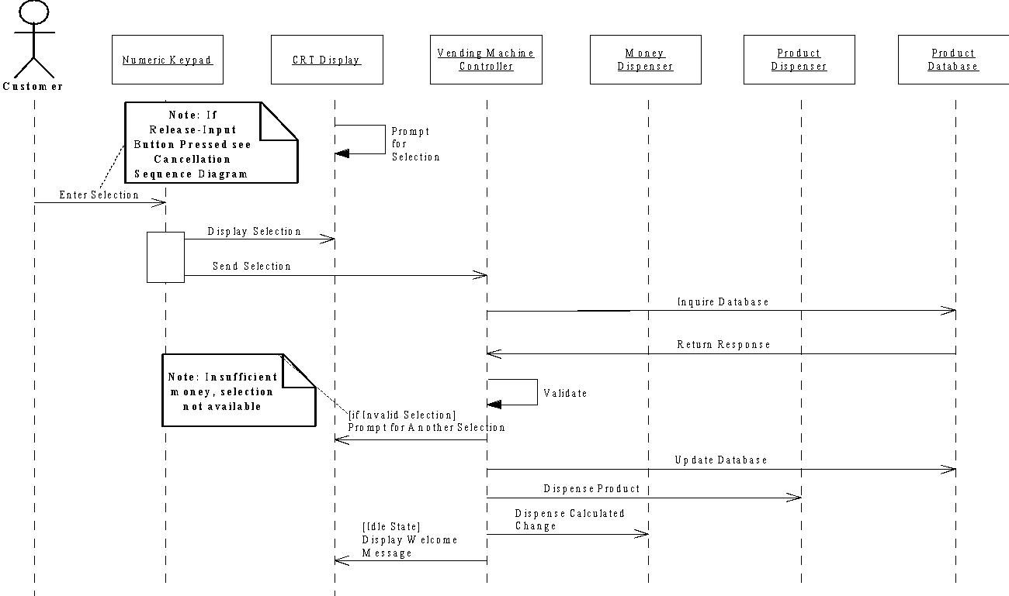
System Sequence Diagram for Make Selection Use Case

Slide 15
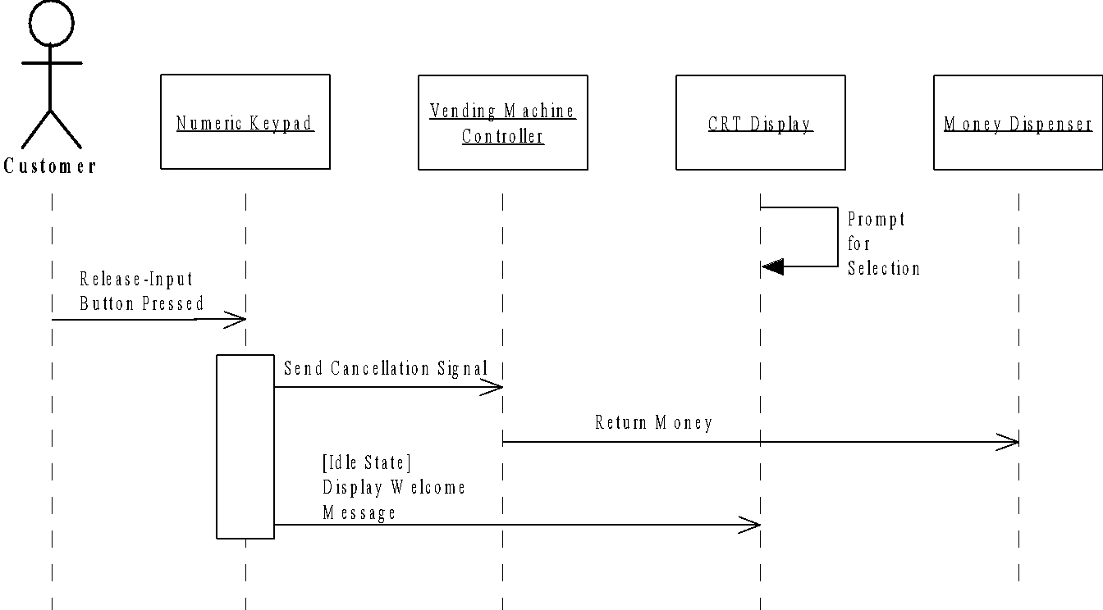
System Sequence Diagram for Cancellation Use Case

Slide 16
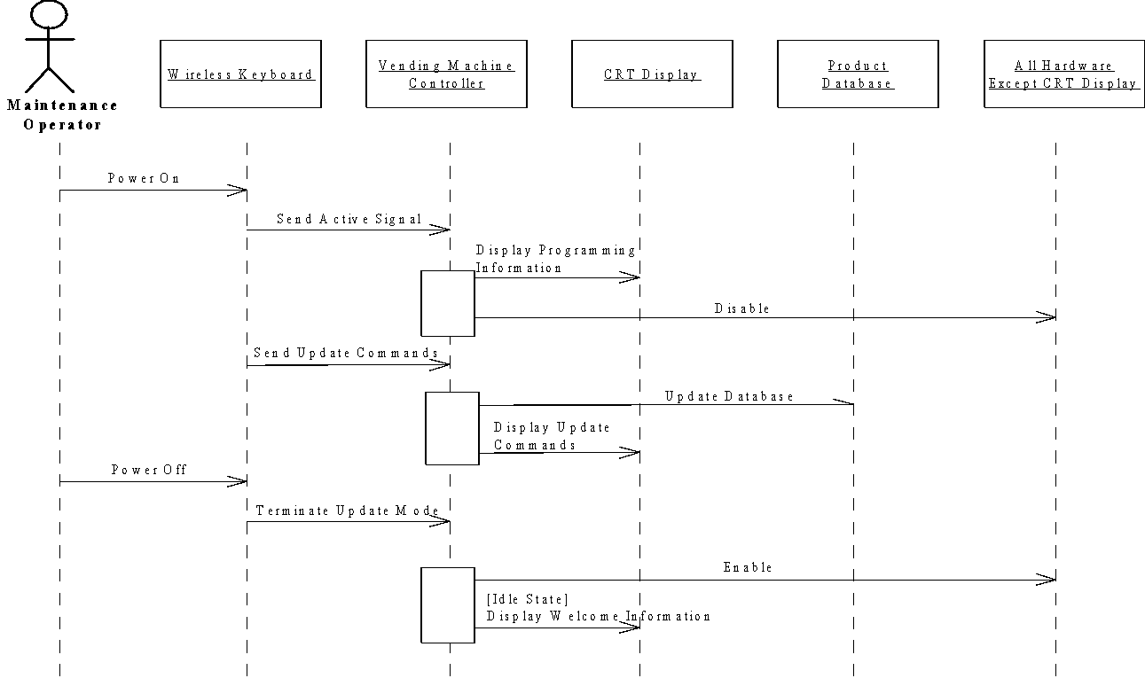
System Sequence Diagram for Update Database Use Case

Slide 17
Building a Sequence Diagram
Determine the context of the sequence diagram
Identify the participating objects
Set the lifeline for each object
Add messages
Add execution occurrence on each object’s lifeline
Validate the sequence diagram
Slide ‹#›

Slide 18
ABEC University’s permanent campus has multiple restaurants inside the campus premises. So the university has developed a system that helps the students of the university order food from those restaurants. To use the system, at first, a student must visit the site and he/she will search for a food item which is passed to the SearchEngine. The SearchEngine then fetches the RestaurantPages from RestaurantDatabase which sells that particular food item, serials them, and returns them to the student. The student then selects the RestaurantPage. From the RestaurantPage, the student adds the item to their cart which sends a request to the StudentCart. After receiving the request, StudentCart adds the item. The student may again search for more than one food item which will be passed to the SearchEngine. In this case, the previous steps will be repeated. However, multiple food items can be added to the StudentCart if all of them belong to the same restaurant. Finally, when the student decides to order all the food items, he/she selects checkout which sends a request to the CartCheckout where the student has to enter his/her student, gsuite email address, phone number, and select the payment method. When all the information has been given, the system confirms the order and shows the estimated delivery time.
Now, draw the sequence diagram for the above scenario.

Slide 19
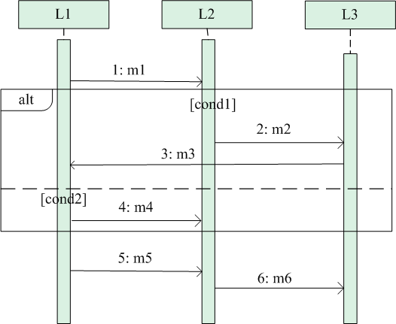
Alternate / if-else scenario in sequence diagram
Upper or lower part will work at a time.
Based on the condition.

Slide 20
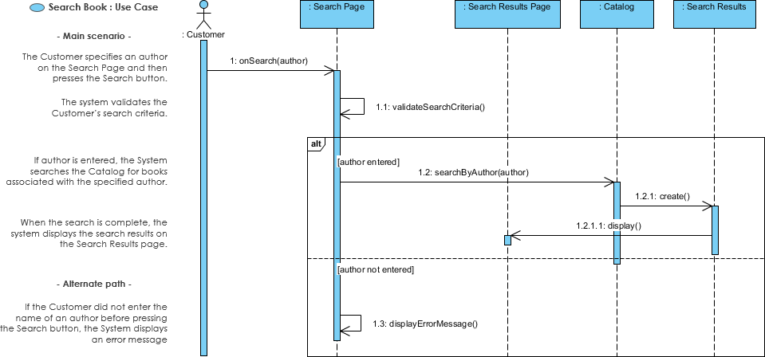
Sequence Diagram for search book Use Case

Slide 21
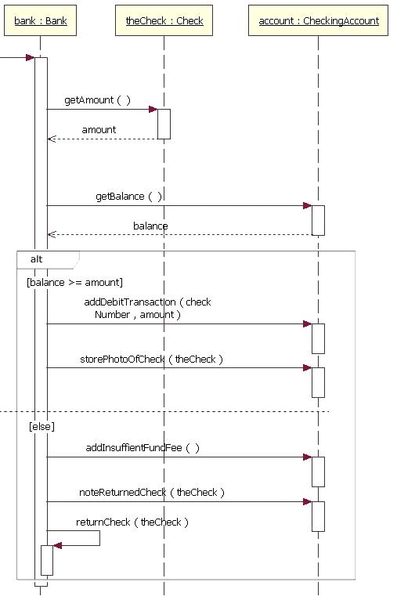

Slide 22
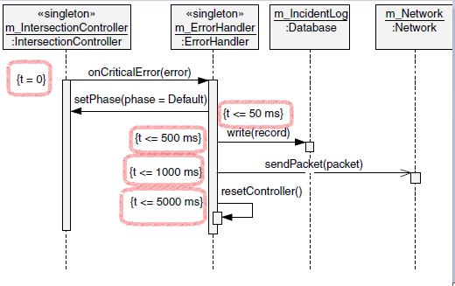
Multiple If-else condition
Slide ‹#›

Slide 23
Thanks
*
‹#›
Notes:
‹#›

